Slide 1

Wilson Bentley

Slide 2
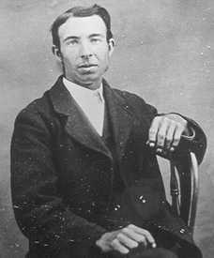
Under the microscope, I found that snowflakes were miracles of beauty; and it seemed a shame that this beauty should not be seen and appreciated by others. Every crystal was a masterpiece of design and no one design was ever repeated., When a snowflake melted, that design was forever lost. Just that much beauty was gone, without leaving any record behind."
Wilson "Snowflake" Bentley 1925

Slide 3
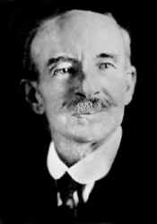
From the earliest memories of our childhood, many of us can remember hearing the phrase "no two snowflakes are alike". This discovery was made in the small rural town of Jericho, Vermont by Wilson A. Bentley (1865-1931).

Slide 4
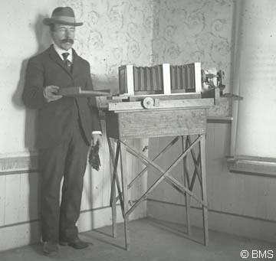
A self educated farmer, Bentley attracted world attention with his pioneering work in the area of photomicrography, most notably his extensive work with snow crystals (commonly known as snowflakes). By adapting a microscope to a bellows camera, and years of trial and error, he became the first person to photograph a single snow crystal in 1885.

Slide 5
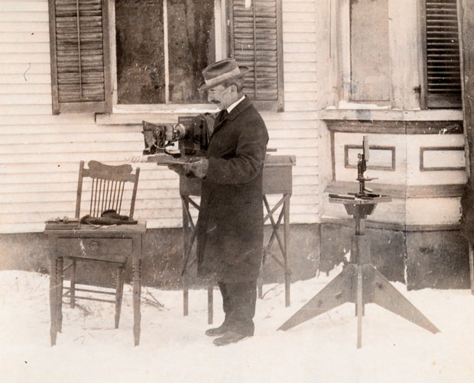
He would go on to capture more than 5000 snowflakes during his lifetime, not finding any two alike
His snow crystal photomicrographs were acquired by colleges and universities throughout the world and he published many articles for magazines and journals including, Scientific American and National Geographic

Slide 6
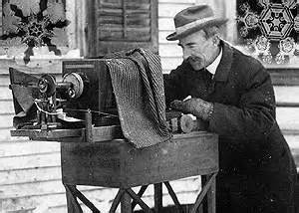
In 1931 his book "Snow Crystals", containing more than 2400 snow crystal images, was published
On December 23, 1931, Bentley died at the family farmhouse in Jericho. Because of his wonderful work with snow crystals, he became affectionately known as "Snowflake" Bentley.

Slide 7
http://www.schooltube.com/video/05547347f48ef29de23e/Wilson%20Bentley%20The%20Snowflake%20Man

Slide 8
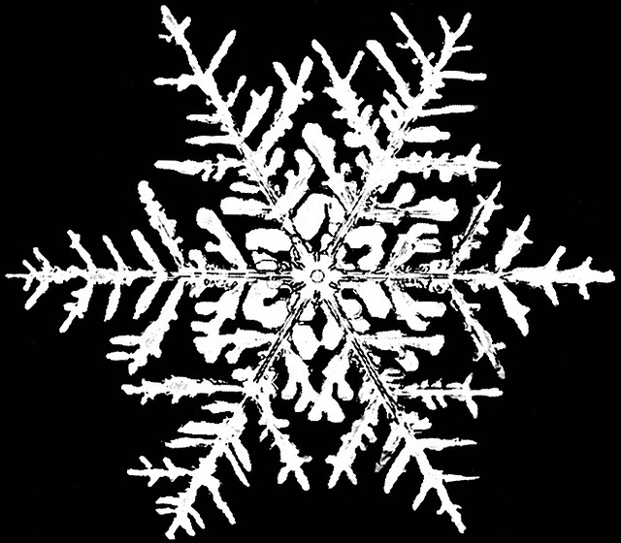

Slide 9
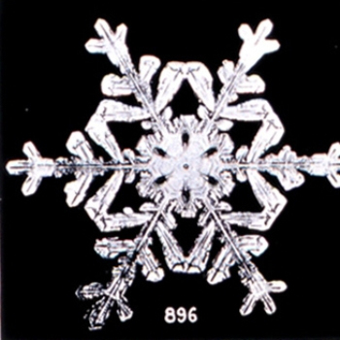

Slide 10
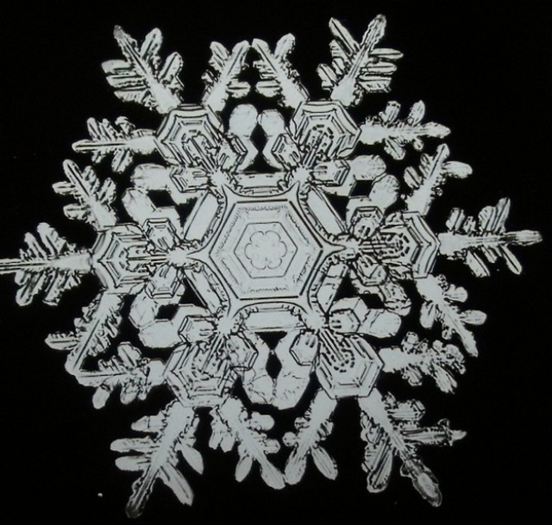

Slide 11
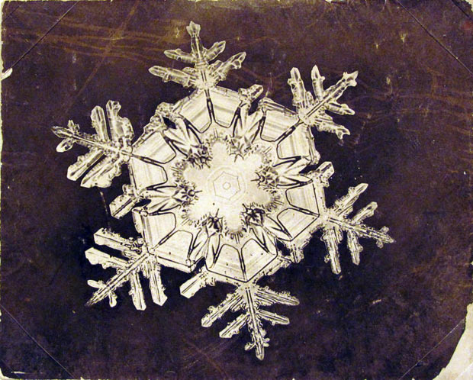

Slide 12
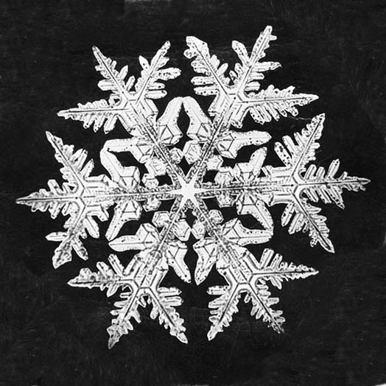

Slide 13
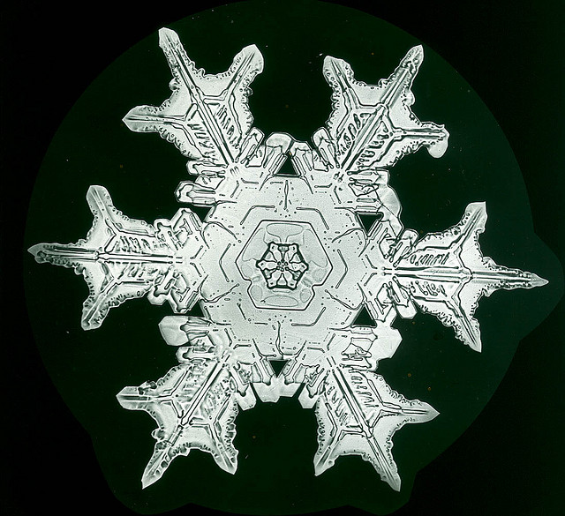

Slide 14
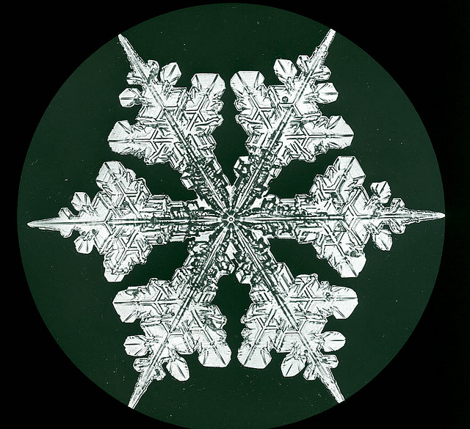

Slide 15
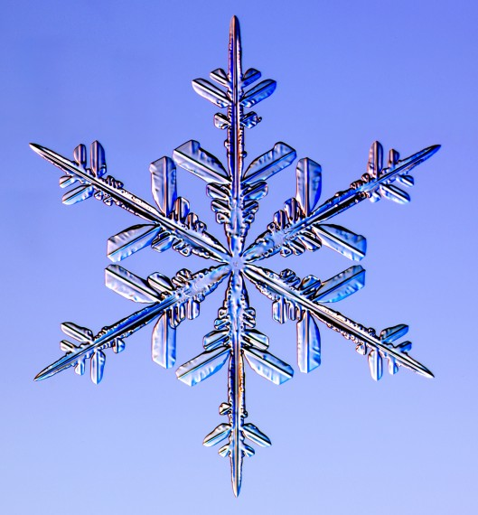
College Professor Kenneth Libbrecht researches how snow crystals are formed. He has written many books on this subject. He photographs snowflakes so he can study their designs.

Slide 16
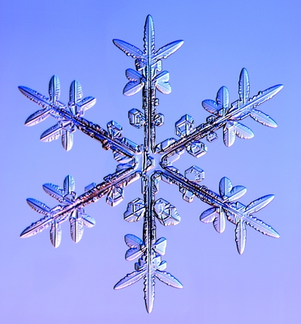

Slide 17
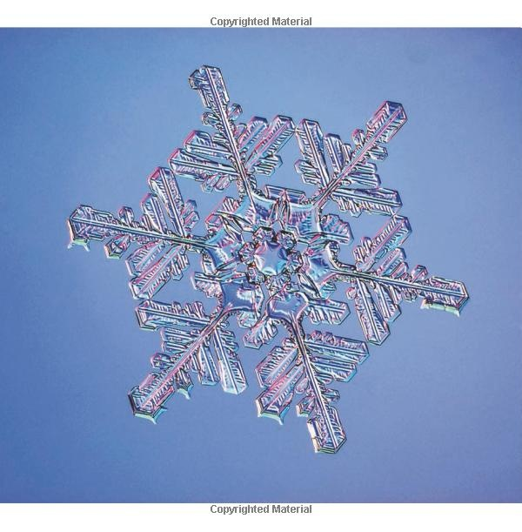

Slide 18
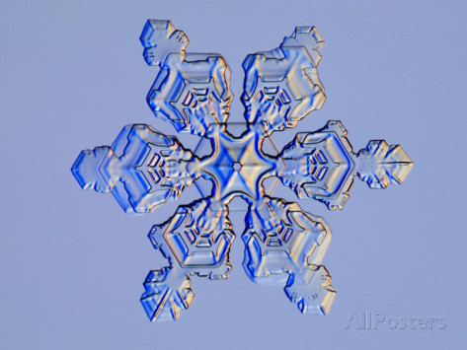

Slide 19
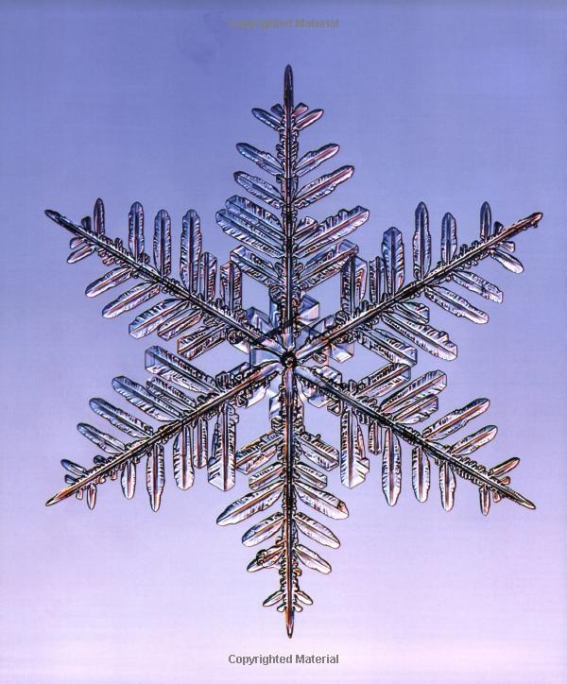

Slide 20
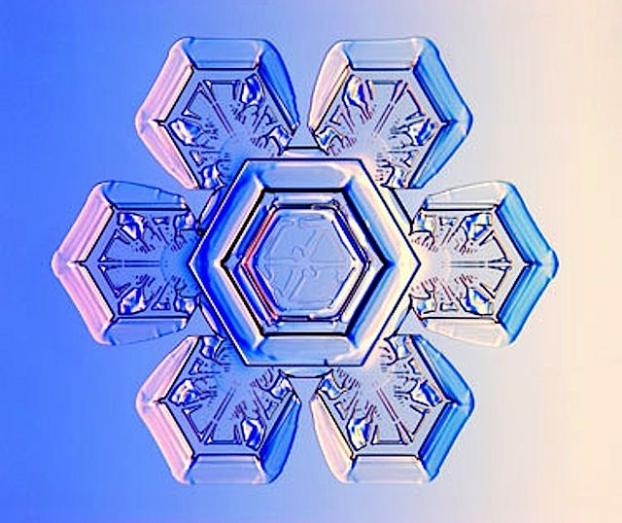

Slide 21
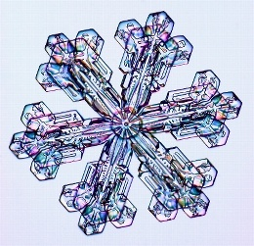

Slide 22
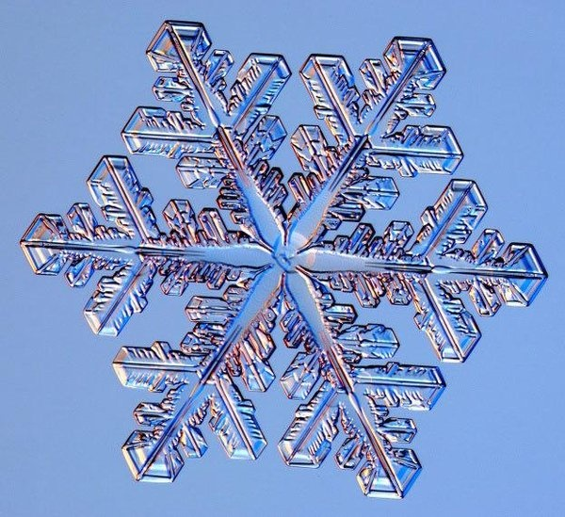

Slide 23


Slide 24
www.SnowflakeBentley.com
www.SnowCrystals.com

